Slide 1
Proteomics David Fenyö

Slide 2
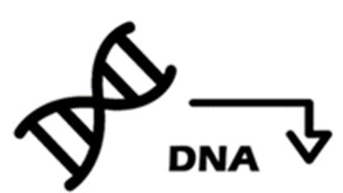

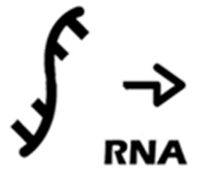
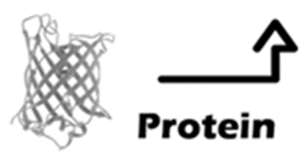
Central Dogma of Molecular Biology
Transcription
Replication
Translation
Modification
P

Slide 3
Central Dogma of Molecular Biology
Transcription
Replication
Translation
Modification
Functional
Gene
Products
P

Slide 4
Central Dogma of Molecular Biology
Transcription
Replication
Easy to
measure
Translation
Modification
P
Difficult to
measure

Slide 5
Central Dogma of Molecular Biology
Transcription
Translation
Modification
P

Slide 6
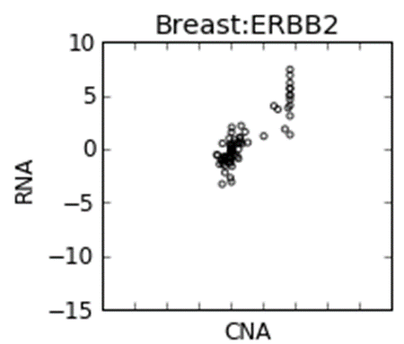

Central Dogma of Molecular Biology
Breast
Cancer
RNA
Transcription
DNA
Translation
Modification
P

Slide 7
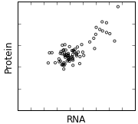
Central Dogma of Molecular Biology
Breast
Cancer
RNA
Transcription
DNA
Translation
Modification
P

Slide 8
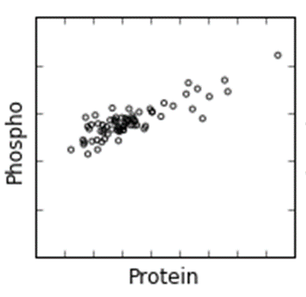
Central Dogma of Molecular Biology
Breast
Cancer
RNA
Transcription
DNA
Translation
Modification
P

Slide 9
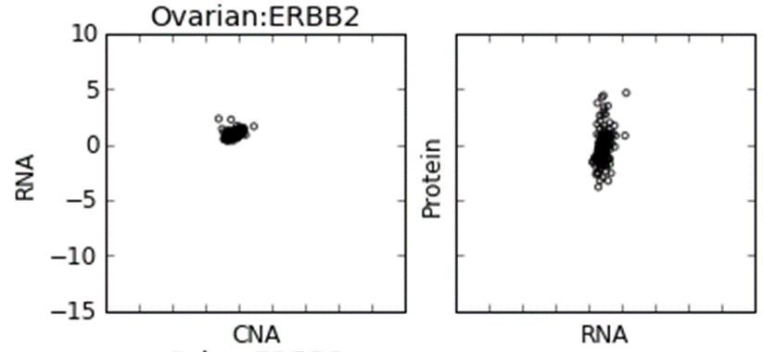

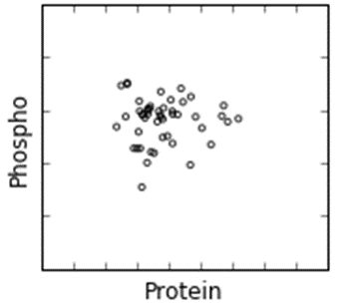
Central Dogma of Molecular Biology
Breast
Cancer
RNA
RNA
Transcription
DNA
DNA
Ovarian
Cancer
Translation
Modification
P

Slide 10
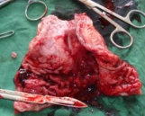
Protein Identification and Quantitation
by Mass Spectrometry
Samples
Peptides
Mass
Spectrometry
Quantity
intensity
m/z
Identity

Slide 11
Overview of Mass spectrometry
Ion Source
Mass Analyzer
Detector
intensity
mass/charge

Slide 12
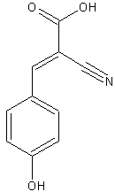
Matrix Assisted Laser Desorption Ionization (MALDI)
Mass Analyzer
Detector
Laser
Matrix
alpha-cyano-4-hydroxycinnamic acid

Slide 13
Time-of-Flight Mass Spectrometry
Ion Source
Mass Analyzer
Detector
Time-of-Flight
Detector

Slide 14
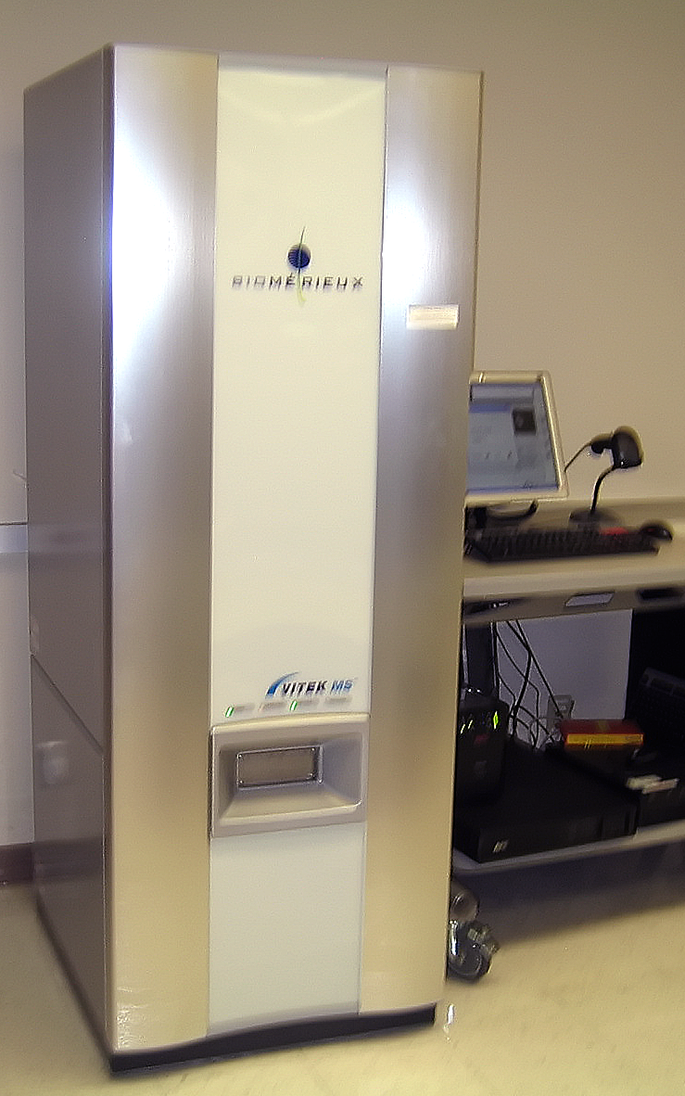
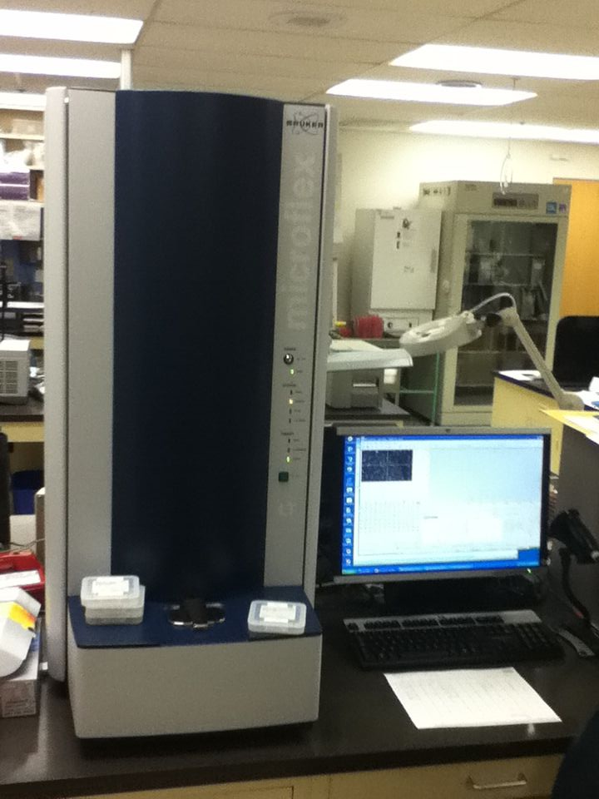
Clinical MALDI-TOF platforms for bacterial identification (not FDA approved)
VITEK MS Bruker BioTyper

Slide 15
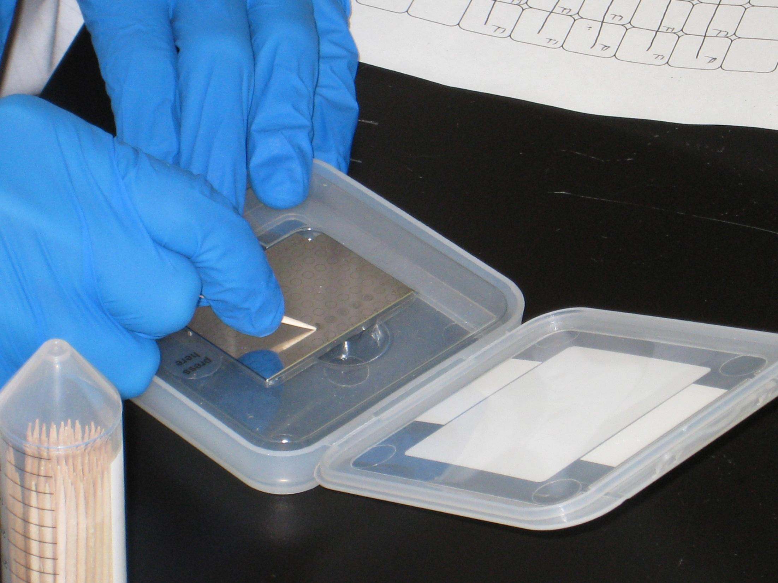
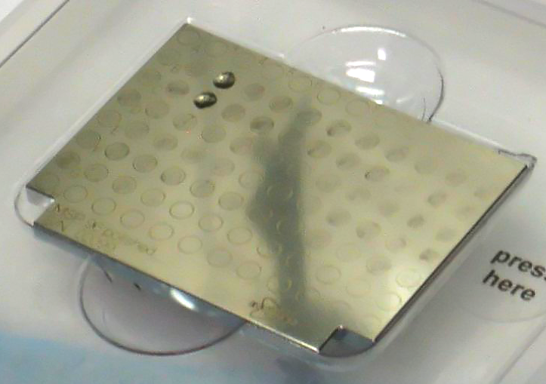
Sample preparation for bacterial identification

Slide 16
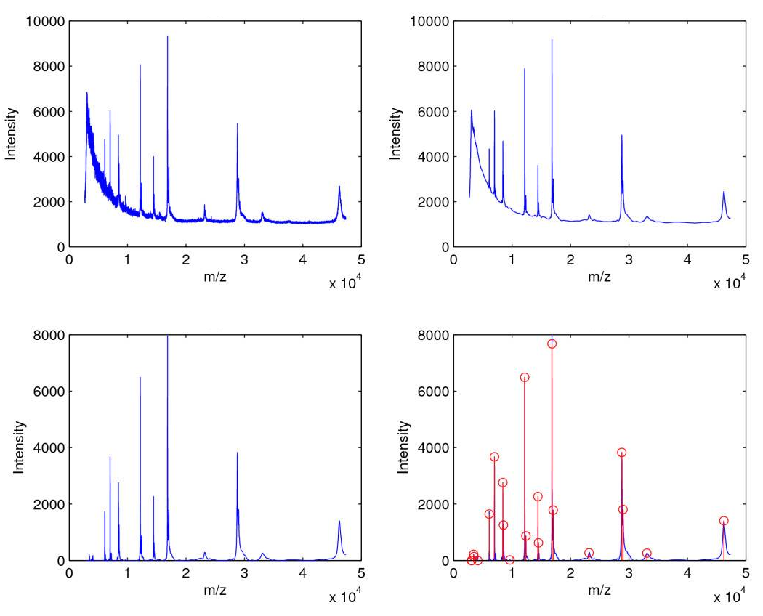
Data collection and processing is automatic
Raw Spectrum
Denoising
Baseline correction
Peakfinding

Slide 17
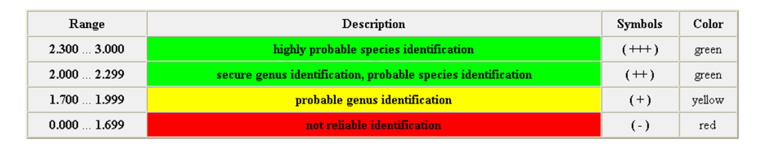
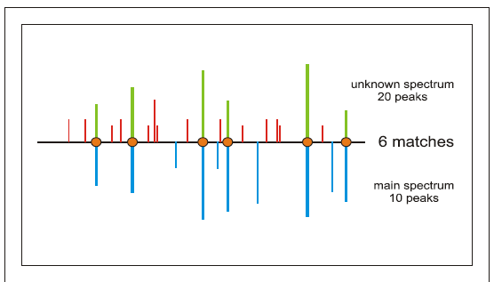
Bacterial identification results
Scores are based on:
The mass of main peaks, and how well this matches a reference
Presence of peaks that do not match reference spectra
(Everything is automatic)

Slide 18
Sample preparation for protein identification,
characterization and quantitation
Lysis
Fractionation
Digestion
Mass spectrometry

Slide 19
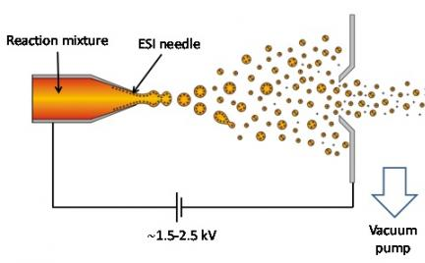
Electrospray
Mass Analyzer
Detector

Slide 20
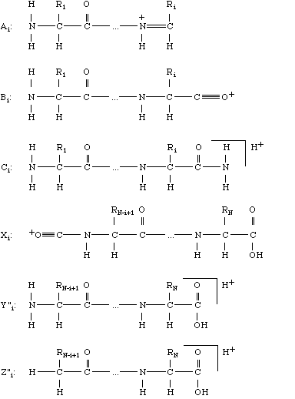
Peptide Fragmentation
Ion Source
Mass Analyzer 1
Frag-mentation
Mass Analyzer 2
Detector
b
y

Slide 21
Interpretation of Mass Spectra
S
G
F
L
E
E
D
E
L
K
100
% Relative Abundance
0
250
500
750
1000
m/z

Slide 22
Interpretation of Mass Spectra
S
G
F
L
E
E
D
E
L
K
88
145
292
405
534
663
778
907
1020
1166
b ions
S
G
F
L
E
E
D
E
L
K
100
% Relative Abundance
0
250
500
750
1000
m/z

Slide 23
Interpretation of Mass Spectra
S
G
F
L
E
E
D
E
L
K
88
145
292
405
534
663
778
907
1020
1166
b ions
S
G
F
L
E
E
D
E
L
K
1166
1080
1022
875
762
633
504
389
260
147
y ions
100
% Relative Abundance
0
250
500
750
1000
m/z

Slide 24
Interpretation of Mass Spectra
S
G
F
L
E
E
D
E
L
K
88
145
292
405
534
663
778
907
1020
1166
b ions
S
G
F
L
E
E
D
E
L
K
1166
1080
1022
875
762
633
504
389
260
147
y ions
762
100
875
[M+2H]²⁺
% Relative Abundance
633
292
405
534
260
389
1022
504
907
1020
663
778
1080
0
250
500
750
1000
m/z

Slide 25
Interpretation of Mass Spectra
S
G
F
L
E
E
D
E
L
K
88
145
292
405
534
663
778
907
1020
1166
b ions
S
G
F
L
E
E
D
E
L
K
1166
1080
1022
875
762
633
504
389
260
147
y ions
762
100
875
[M+2H]²⁺
% Relative Abundance
633
292
405
534
260
389
1022
504
907
1020
663
778
1080
0
250
500
750
1000
m/z

Slide 26
Interpretation of Mass Spectra
S
G
F
L
E
E
D
E
L
K
88
145
292
405
534
663
778
907
1020
1166
b ions
S
G
F
L
E
E
D
E
L
K
1166
1080
1022
875
762
633
504
389
260
147
y ions
762
100
875
[M+2H]²⁺
113
113
% Relative Abundance
633
292
405
534
260
389
1022
504
907
1020
663
778
1080
0
250
500
750
1000
m/z

Slide 27
Interpretation of Mass Spectra
S
G
F
L
E
E
D
E
L
K
88
145
292
405
534
663
778
907
1020
1166
b ions
S
G
F
L
E
E
D
E
L
K
1166
1080
1022
875
762
633
504
389
260
147
y ions
762
100
129
875
[M+2H]²⁺
% Relative Abundance
129
633
292
405
534
260
389
1022
504
907
1020
663
778
1080
0
250
500
750
1000
m/z

Slide 28
Liquid Chromatography (LC)-MS/MS
LC
Ion Source
Mass Analyzer 1
Frag-mentation
Mass Analyzer 2
Detector
intensity
intensity
intensity
intensity
intensity
intensity
intensity
intensity
intensity
intensity
intensity
intensity
intensity
intensity
intensity
mass/charge
mass/charge
mass/charge
mass/charge
mass/charge
mass/charge
mass/charge
mass/charge
mass/charge
mass/charge
mass/charge
mass/charge
mass/charge
mass/charge
mass/charge
Time

Slide 29
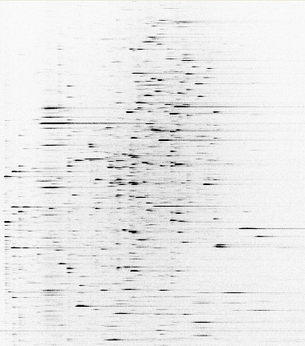
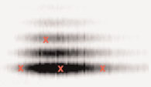
Example data – ESI-LC-MS/MS
Peptide intensity vs m/z vs time
m/z
762
MS/MS
100
875
[M+2H]²⁺
% Relative Abundance
292
633
260
405
534
1022
389
504
907
1020
663
778
1080
0
250
500
750
1000
m/z
Fragment intensity vs m/z
Time

Slide 30
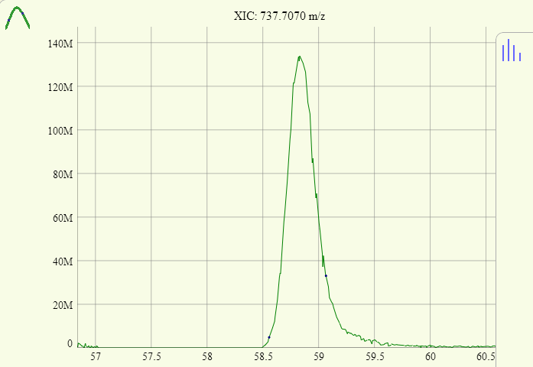
Example Mass Spectrometry Data
Peptide intensity vs time
For 737.707 m/z which corresponds to 3+ of LGEHNIDVLEGNEQFINAAK

Slide 31
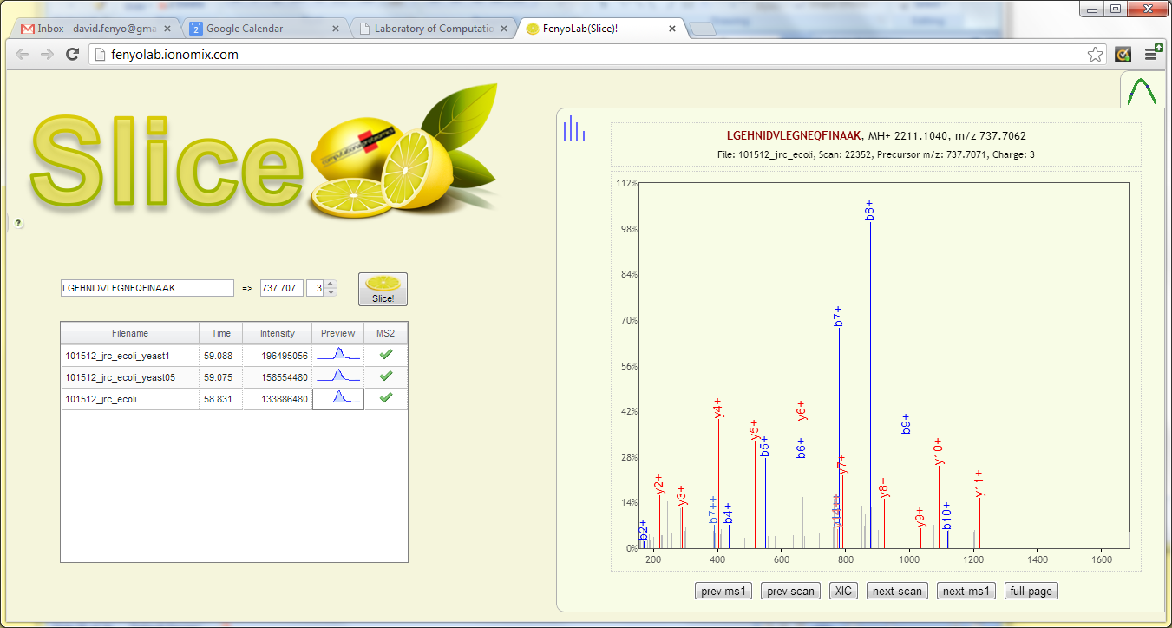

Example Mass Spectrometry Data
Fragment intensity vs m/z
For 3+ of LGEHNIDVLEGNEQFINAAK

Slide 32
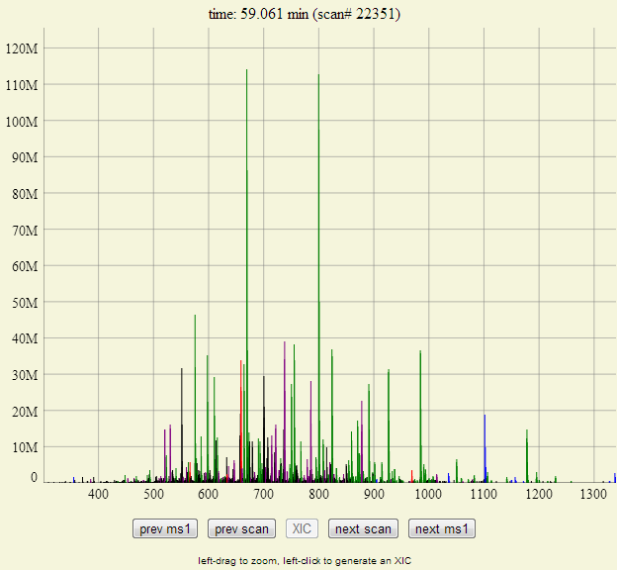
Example Mass Spectrometry Data
3+ of LGEHNIDVLEGNEQFINAAK
Peptide intensity vs m/z

Slide 33
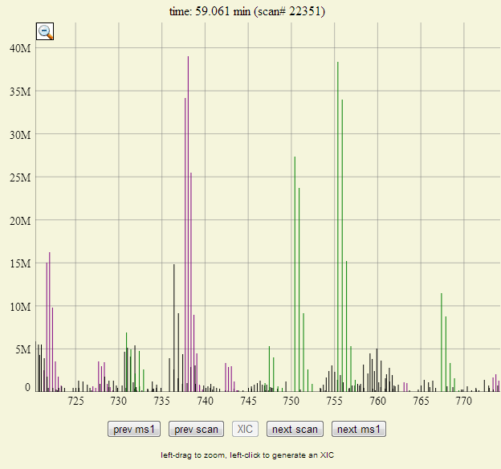
Example Mass Spectrometry Data
3+ of LGEHNIDVLEGNEQFINAAK
Peptide intensity vs m/z

Slide 34
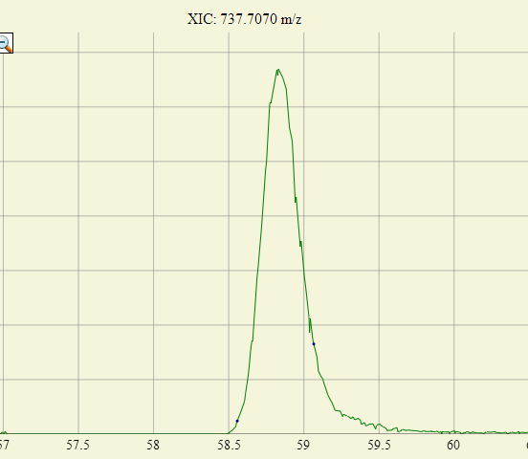
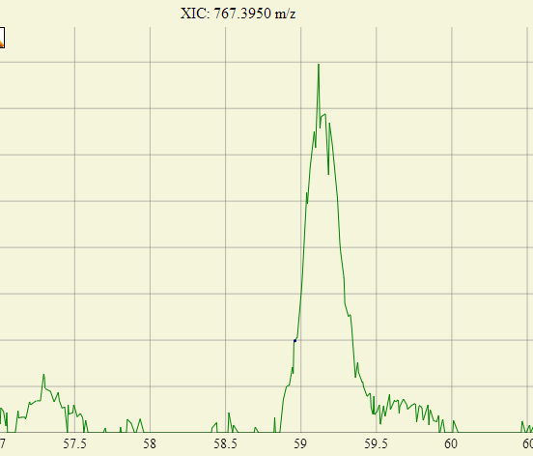
Example Mass Spectrometry Data
Peptide intensity vs m/z
Peptide intensity vs time

Slide 35
Protein Identification
by Mass Spectrometry
Samples
Peptides
Mass
Spectrometry
intensity
m/z
Identity

Slide 36
Tandem MS – Database Search
Sequence
DB
Lysis
Fractionation
Pick Protein
Digestion
LC-MS
Pick Peptide
MS/MS
Repeat for all proteins
All Fragment
Masses
Repeat for
all peptides
MS/MS
Compare, Score, Test Significance

Slide 37
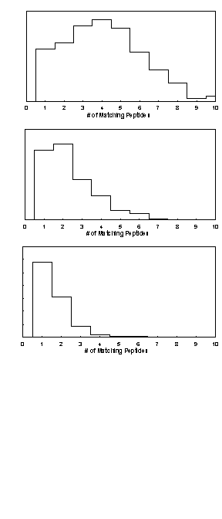
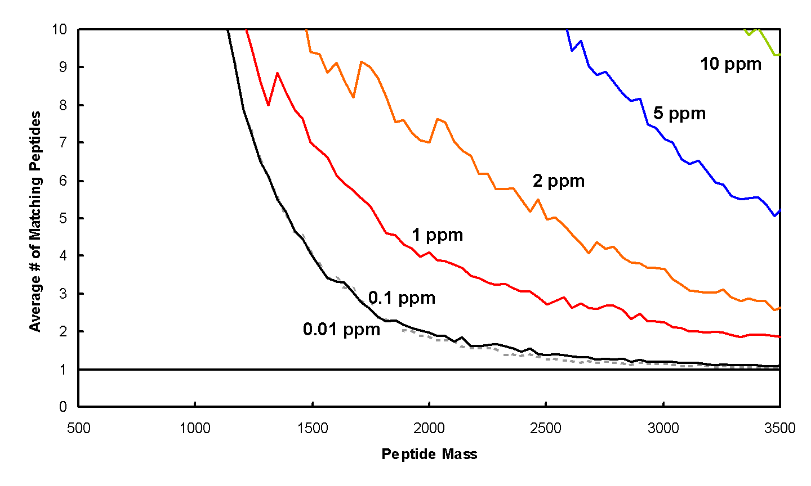
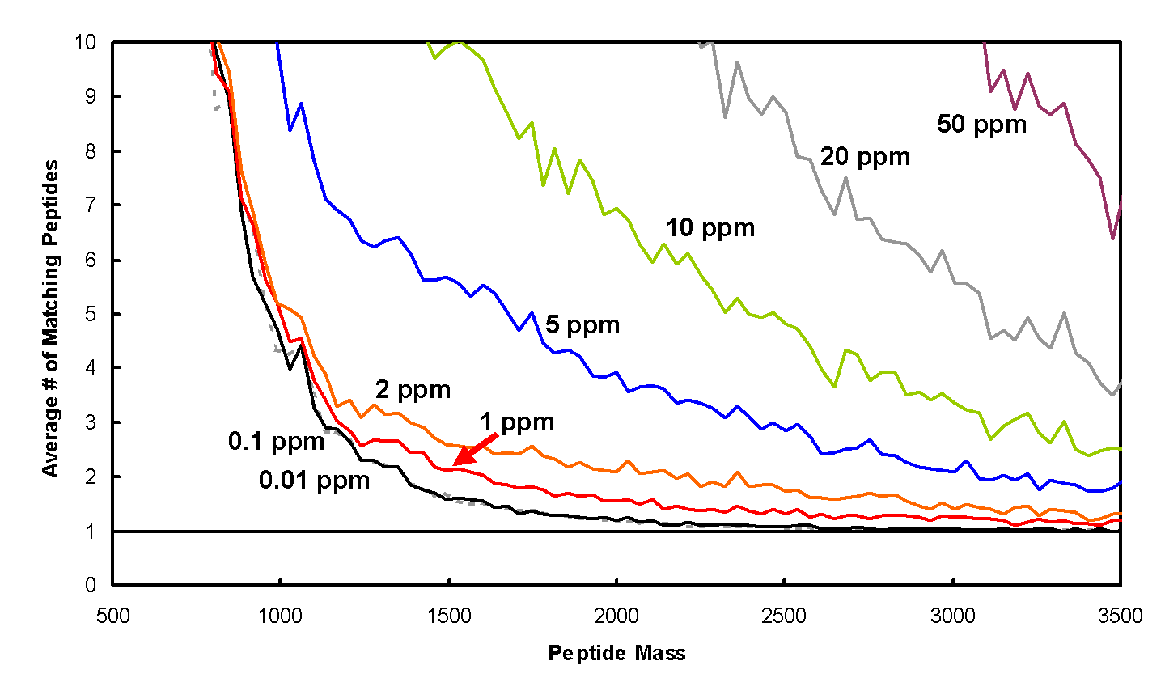
Information Content in a Single Mass Measurement
Human
10
8
6
Avg. #of matching peptides
4
3
2
1 2 3 4 6 8 10
1
#of matching peptides
1000 2000 3000
Tryptic peptide mass [Da]
S. cerevisiae
10
8
6
Avg. #of matching peptides
4
3
2
1 2 3 4 6 8 10
1
#of matching peptides
1000 2000 3000
Tryptic peptide mass [Da]

Slide 38
Protein Identification and Quantitation
by Mass Spectrometry
Samples
Peptides
Mass
Spectrometry
Quantity
intensity
m/z

Slide 39
Protein Quantitation by Mass Spectrometry
Sample i
Protein j
Peptide k
Lysis
Fractionation
Digestion
MS
LC-MS

Slide 40
Quantitation – Label-Free (MS)
Sample i
Protein j
Peptide k
Lysis
Assumption:
constant for all samples
Fractionation
Digestion
LC-MS
MS
MS

Slide 41
Quantitation – Metabolic Labeling
Light
Heavy
Lysis
Fractionation
Digestion
LC-MS
Sample i
Protein j
Peptide k
MS
L
H
Oda et al. PNAS 96 (1999) 6591
Ong et al. MCP 1 (2002) 376

Slide 42
Target Assays
Lysis
Fractionation
Digestion
Synthetic
Peptides
(Heavy)
Light
Enrichment with
Peptide antibody
LC-MS
Anderson, N.L., et al.
Proteomics 3 (2004) 235-44
MS
L
H

Slide 43
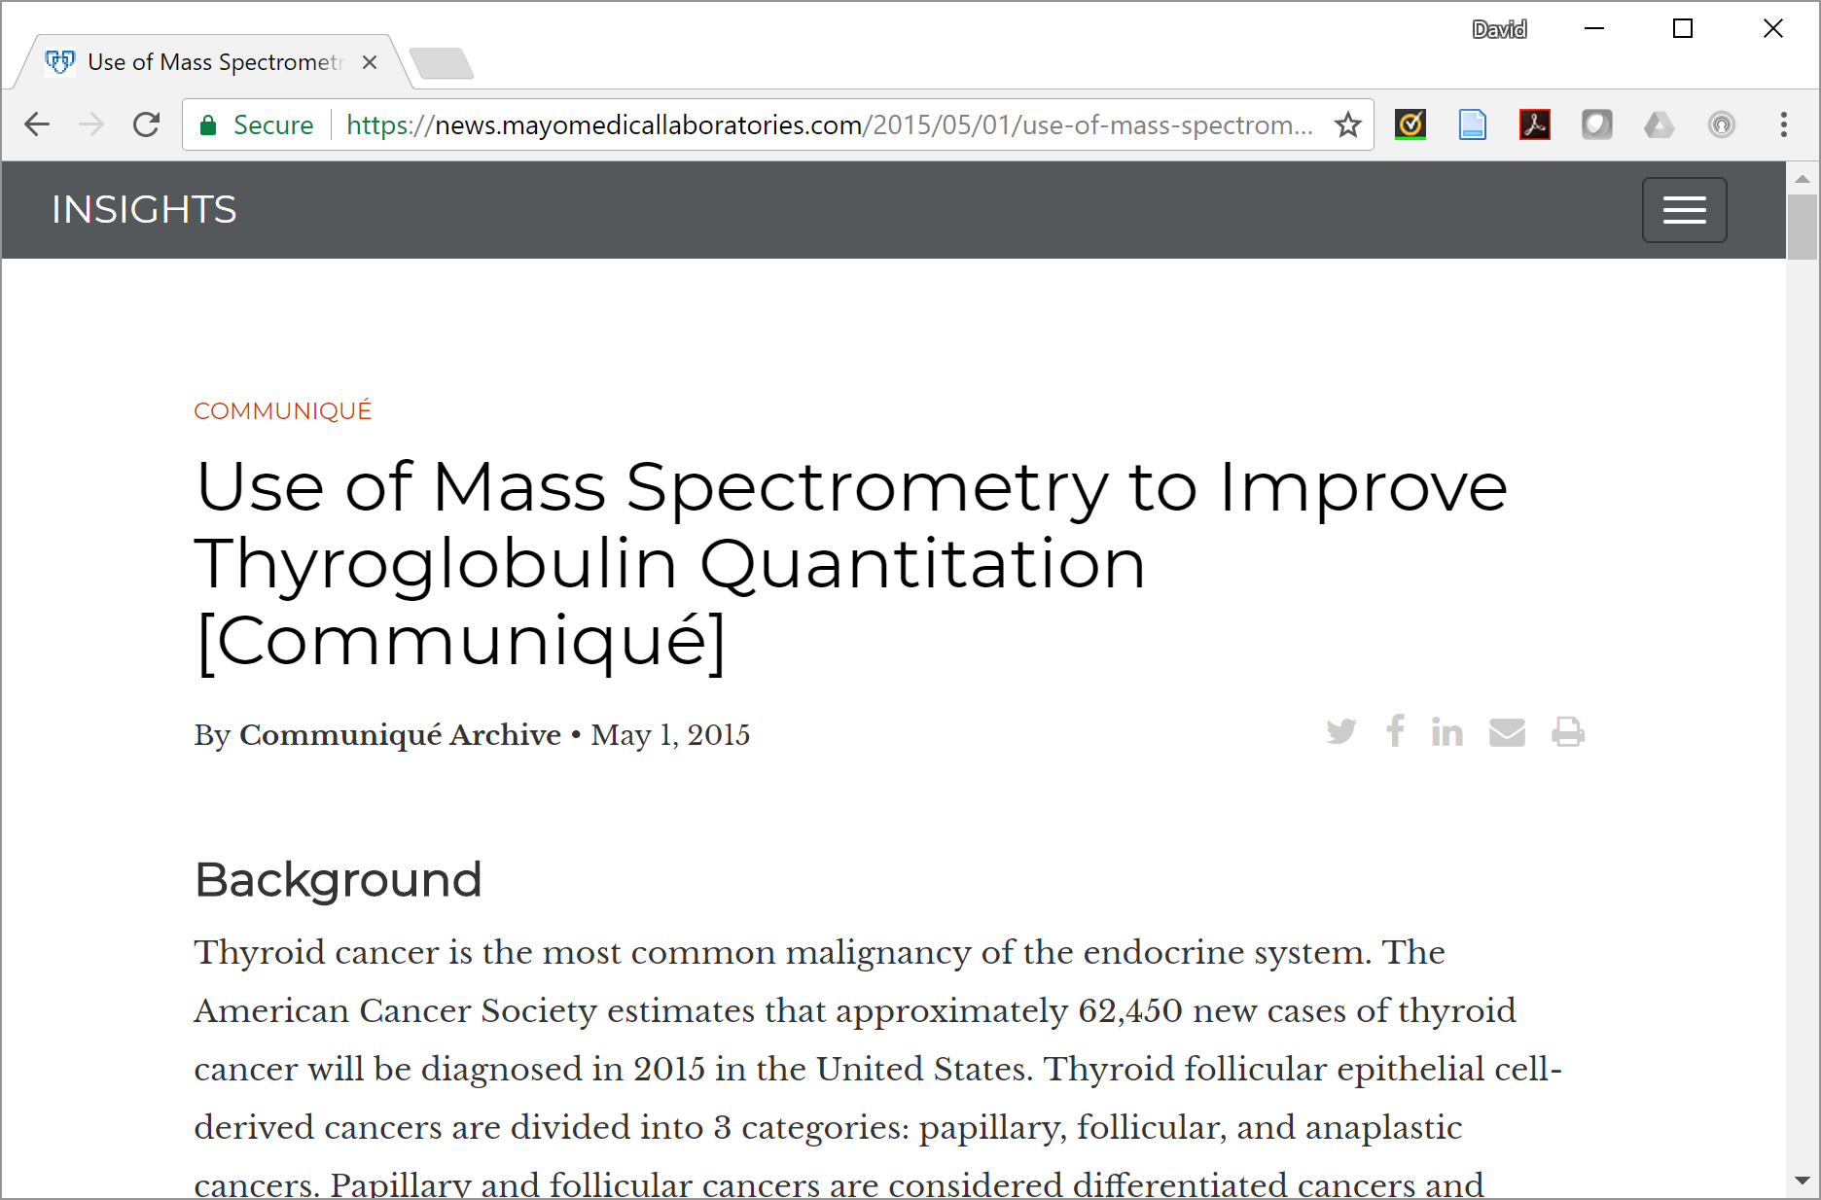
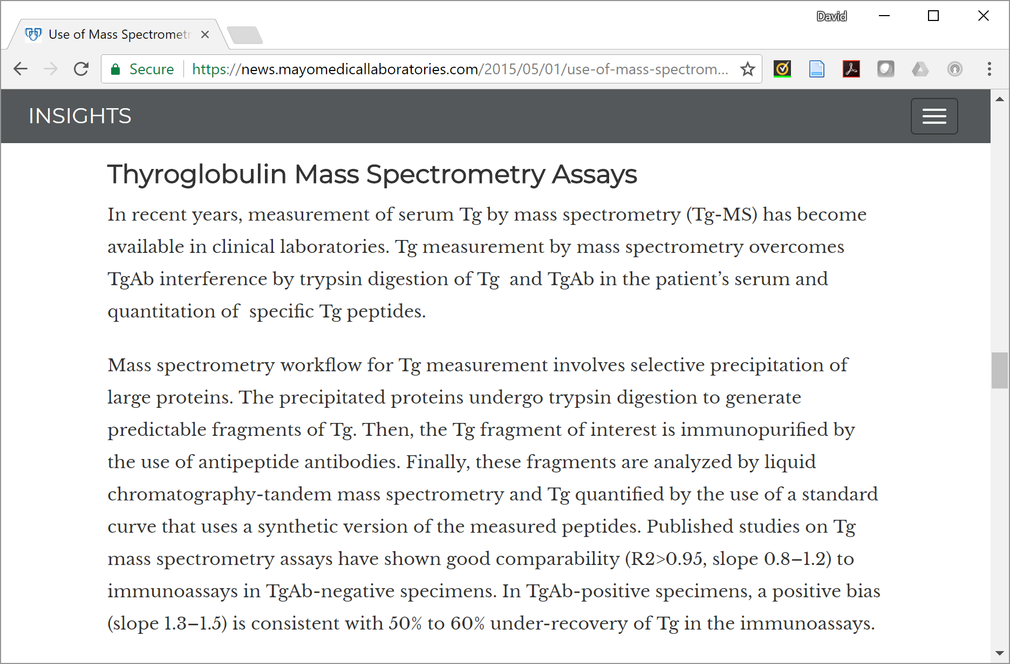
A Mass Spectrometry Based Clinical Assay

Slide 44

https://www.nytimes.com/interactive/2018/11/15/magazine/tech-design-proteomics.html

